Slide 1



A2 – Storyboard and Low-Fi Prototypes
UrbanHub
Inclusive and effortless Urban Travel
Presentation

Slide 2


1
Introduction

Slide 3




Team members
Sylvie Molinatto
Alessandro Bianco
Elia Ferraro
Kevin Gjeka
I'm a 22 years old Computer Engineering student from Condove, a little town near Turin. I have a deep enthusiasm for computer science and its potential to create a positive and valuable impact on society.
I’m a 23 years old student from Ciriè, near Turin. My two biggest passions are computer engineering and sports. I am currently
studying cybersecurity and I hope to make it my future career.
I’m a 24-year-old student from Asti. I really like software development and music because they are tools to generate emotions from very simple ideas that can improve the lives of people who use them.
I am a 23 years old Cybersecurity Engineering student from Turin. I have a keen interest in cybersecurity and ethical hacking and I hope to contribute to this space in the future.

Slide 4

UrbanHub
Inclusive and effortless Urban Travel

Slide 5

UrbanHub
Inclusive and effortless Urban Travel We decided to call our project «UrbanHub» because this name emphasizes the urban aspect of the project, making it clear that it's centered around city and urban travel, and suggests a central place or location for gathering information and resources. In the context of trip planning, it indicates that the project serves as a central hub for urban travelers to access everything they need. Indeed, the term "urban" relates to cities and the associated infrastructure, services, and living environments. "Hub" typically implies a central point or a place where various activities, services, or resources converge.

Slide 6

Problem
Through the 5 conducted interviews, as a team, we were able to gain insights into the recurring needs of individuals when planning a trip. What we have understood is that people require the ability to plan a trip quickly and easily, tailored to their specific needs. Additionally, other crucial aspects include the reliability and completeness of information, and finally, the option to reschedule activities in case of unforeseen circumstances.

Slide 7

Solution
The proposed solution involves the utilization of surveys to gather information about user’s preferences and constraints, thereby facilitating the tailoring of the suggested itinerary to align with individual needs. The aim of the project is to ensure a level of customization that goes beyond generic recommendations. As a consequence, the project consists in creating a centralized platform where users can input their requirements and preferences, allowing them to receive a tailored trip itinerary.

Slide 8
Tasks and Storyboards
2

Slide 9

Simple task
Select a destination and a time period
Entering a destination and a time period is a straightforward and commonly performed task. Users are typically familiar with inputting information, and it requires minimal decision-making. The task involves a single action, and users are guided by prompts to enter the desired city and dates. The simplicity lies in the familiarity of the action and the clarity of the user's goal.

Slide 10

Moderate task
Insert needs and preferences to get a personalized itinerary
This task involves a moderate level of complexity due to the additional decision-making and customization required. Users need to articulate their specific interests, set a budget, and initiate the generation of a personalized itinerary. While it's user-friendly, it introduces more variables and preferences, making it moderately complex. The app's ability to process these inputs and generate a tailored itinerary adds a layer of sophistication.

Slide 11

Complex task
Modify/Reschedule the trip plan
Modifying or regenerating an itinerary introduces complexity as it requires users to interact with an existing plan. Users may want to adjust specific details, durations, or add/remove activities, necessitating a more advanced level of interaction. The app needs to handle dynamic changes to the itinerary intelligently. Complexity arises from managing multiple components of the itinerary and ensuring seamless adjustments without disrupting the overall coherence of the plan.

Slide 12
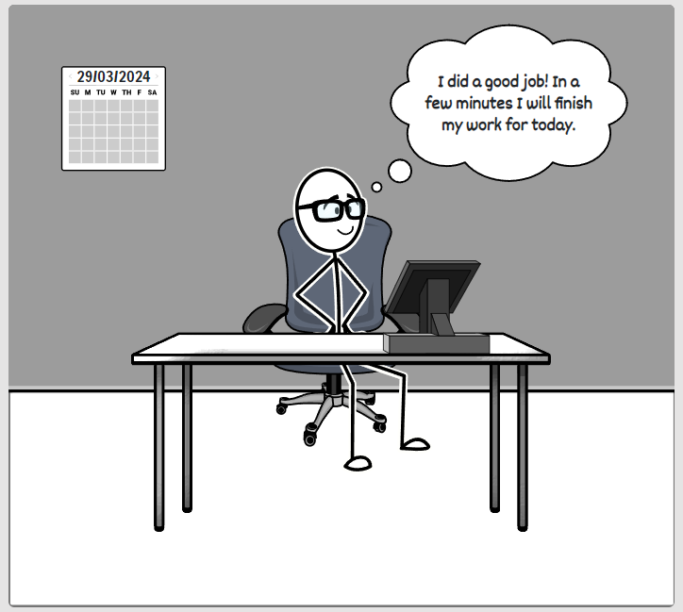
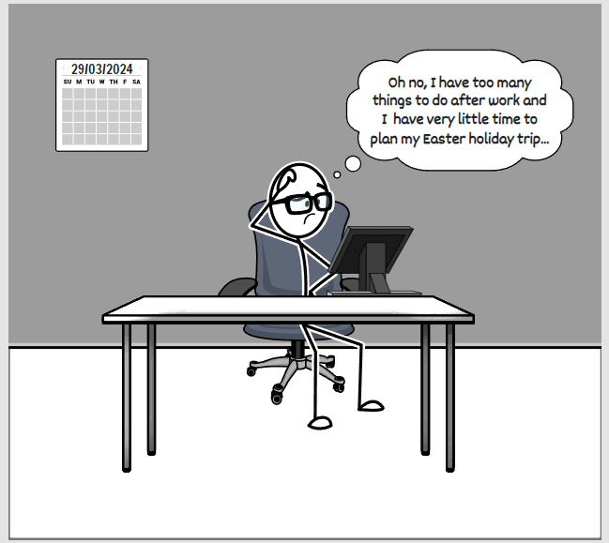
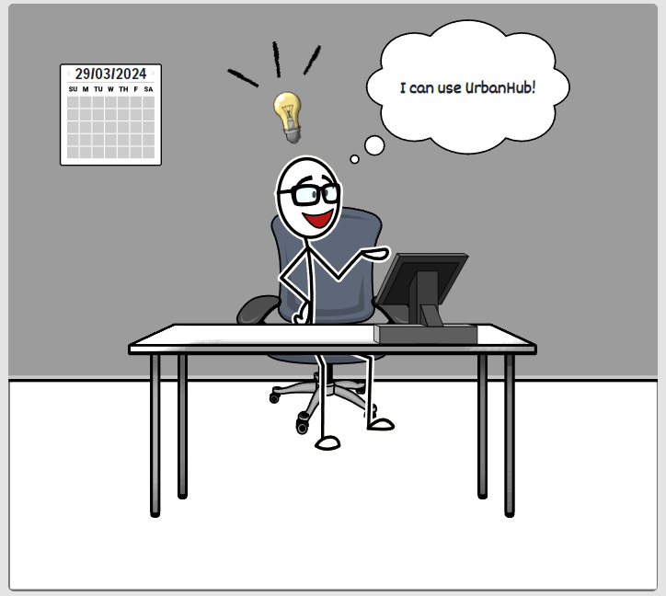
Storyboard

Slide 13
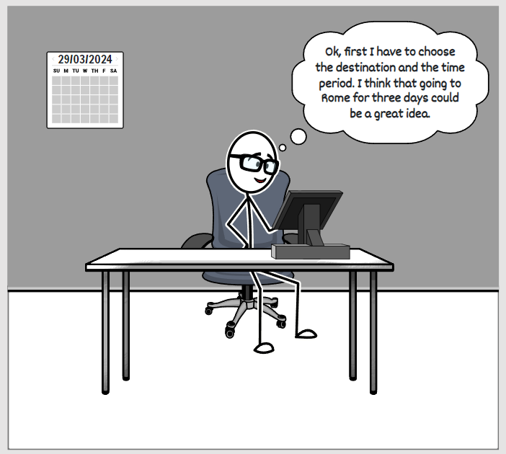
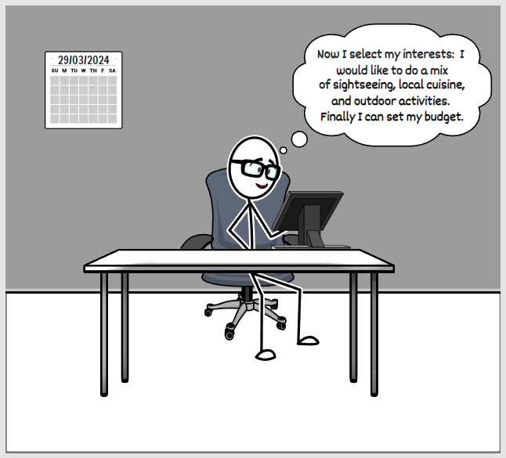
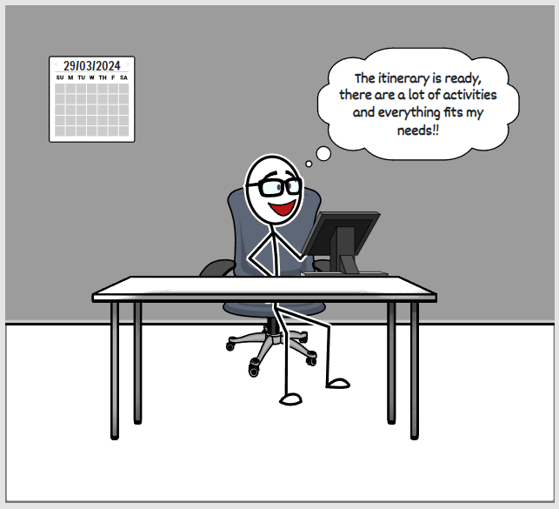
Storyboard

Slide 14
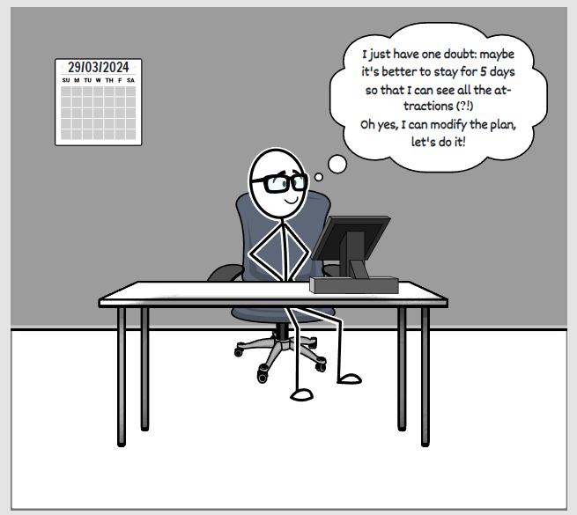
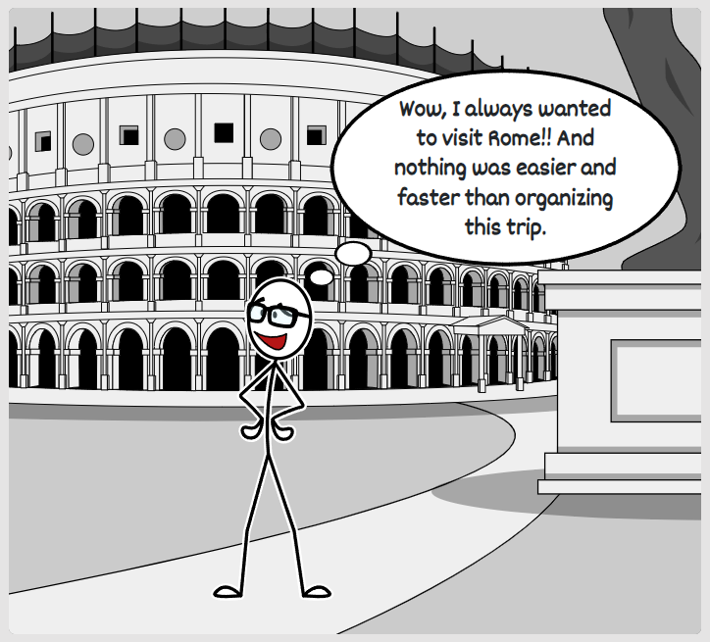
Storyboard

Slide 15
Storyboard - Why ?
We decided to use a simple storyboard to keep things clear. This decision reflects our commitment to presenting complex details in a clear and easily understandable manner. We created this storyboard because it encapsulates the essence of UrbanHub: simplicity, efficiency, and personalization. By understanding the real needs of our users and crafting a narrative that mirrors their experiences, we aim to provide a travel planning solution that seamlessly integrates into their lives.

Slide 16



Storyboard - Strengths
User-Centric Approach
Clear Flow of Tasks
Personalization Highlighted
The storyboard effectively portrays a user-centered scenario, emphasizing the protagonist’s real-world problem and need for a quick and stress-free trip planning solution.
The tasks (entering a destination, providing interests, and modifying the itinerary) are presented in a logical sequence, making the user journey easy to follow.
The storyboard emphasizes the personalization aspect, showcasing how UrbanHub tailors the itinerary based on the protagonist preferences and constraints.

Slide 17
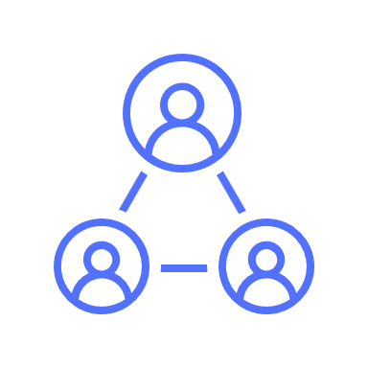

Storyboard - Weaknesses
Limited Context
Simplicity Over Details
The scenario is somewhat limited in scope, focusing solely on the protagonist’s need for a last-minute trip. It may not capture the diversity of user scenarios and requirements.
While simplicity is a strength, the storyboard may lack depth in showcasing the intricacies of UrbanHub's features. It provides a high-level overview but may not cover all functionalities.

Slide 18
Storyboard - Resume
The storyboard successfully achieves the identified goals and user needs. It creates a narrative that resonates with users, showcasing the app's ability to personalize, operate swiftly, adapt to changes, and provide trustworthy information. This positions UrbanHub as a user-friendly and efficient solution for urban travel planning.

Slide 19
Modalities exploration
3

Slide 20
Modalities exploration
Moving from theory to practical implementation, our team explored some ways to give substance to our concepts, with a particular focus on integrating Artificial Intelligence. We considered various options:
A mobile app emerged as a strong choice due to the widespread use of smartphones.
Another option under consideration was a website that calculates itineraries based on user-provided responses.
We explored the feasibility of a chatbot because it provides an intuitive and inclusive interaction method with the system.

Slide 21
Modalities exploration
After a thorough evaluation, our team decided to exclude the chatbot. Although it is intuitive and inclusive, there were concerns about its ability to handle the extensive information needed to plan a personalized trip based on user preferences. Additionally, there were worries about its compatibility with the significant data load our centralized platform must generate for users. As a result, we have chosen to focus on the mobile-based application and the web application as our preferred modalities.

Slide 22


Selected Alternatives
Web application
Mobile application
The two options allow the user to experience an approach with artificial intelligence in different ways

Slide 23
Web application- Motivation
The utilization of a web application stands as a viable option, given that users can conveniently access it from both mobile devices and desktop computers, thereby augmenting the versatility of our solution. Our conceptualization for this particular solution involves the incorporation of artificial intelligence (AI) capabilities. Specifically, we intend to integrate AI functionalities to generate pertinent questions and assess user responses systematically. This proactive approach will precede the presentation of the proposed itinerary to ensure a tailored and well-informed travel plan for the user.
Web application

Slide 24
Mobile-based app - Motivation
According to what we gathered from interviews, people seem to have interest in a fast and easy way to plan a urban trip, so the mobile app is one of the best choices for that objective. The fastest way for a user to communicate with a system is using his voice, so we decided to exploit the AI to recognize the user preferences from a vocal recording. Indeed, voice interaction can offer a convenient and inclusive way for users to provide their preferences and limitations. Users can verbally express their needs, such as accessibility requirements or sensory preferences, in a natural and efficient manner. Voice technology, coupled with natural language processing, can quickly gather user input and tailor trip suggestions accordingly.
Mobile application

Slide 25
Paper prototype #1
4

Slide 26
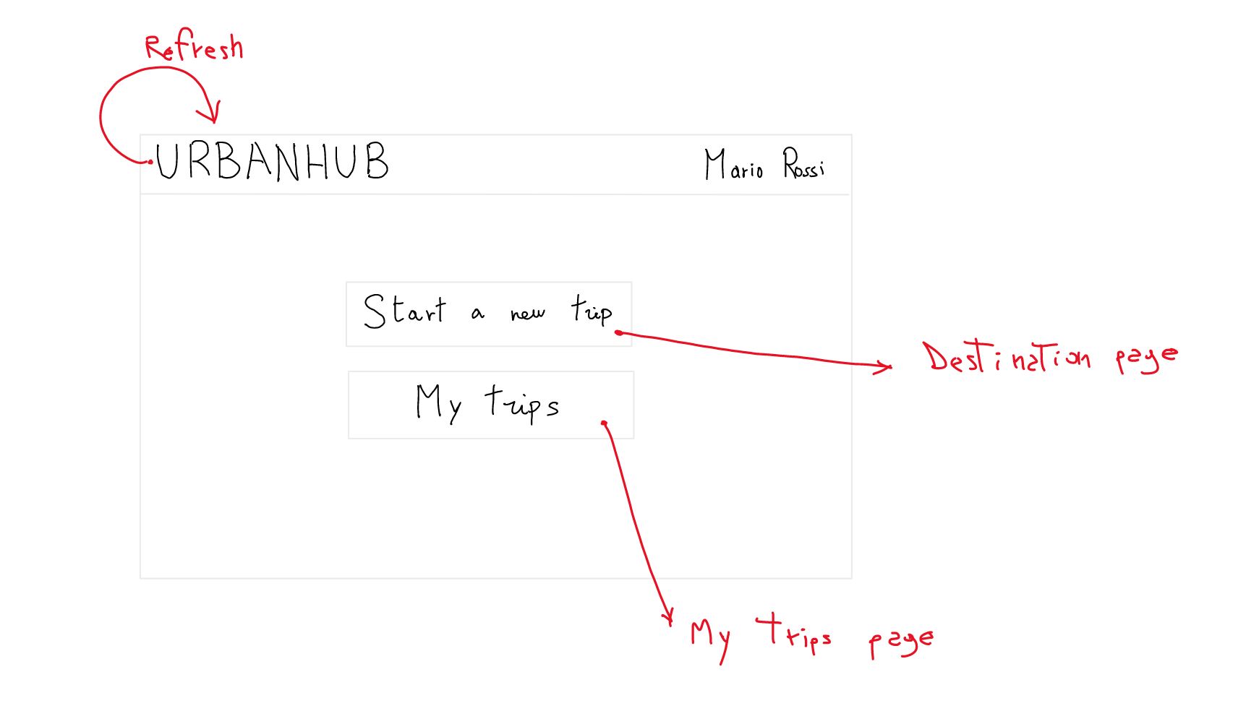
Homepage

Slide 27
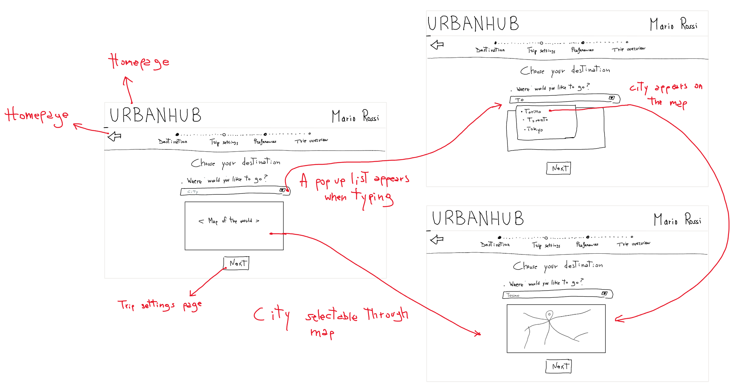
Destination page

Slide 28
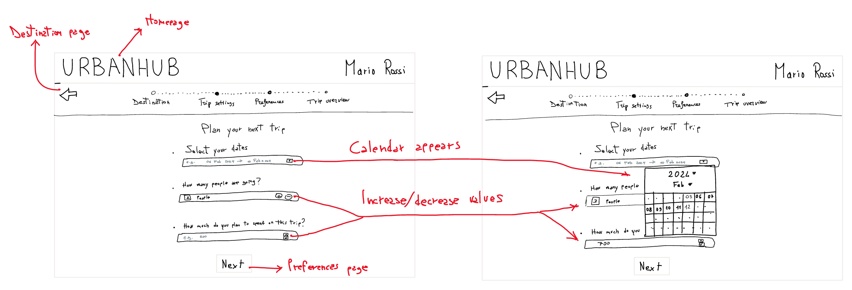
Trip Settings page

Slide 29
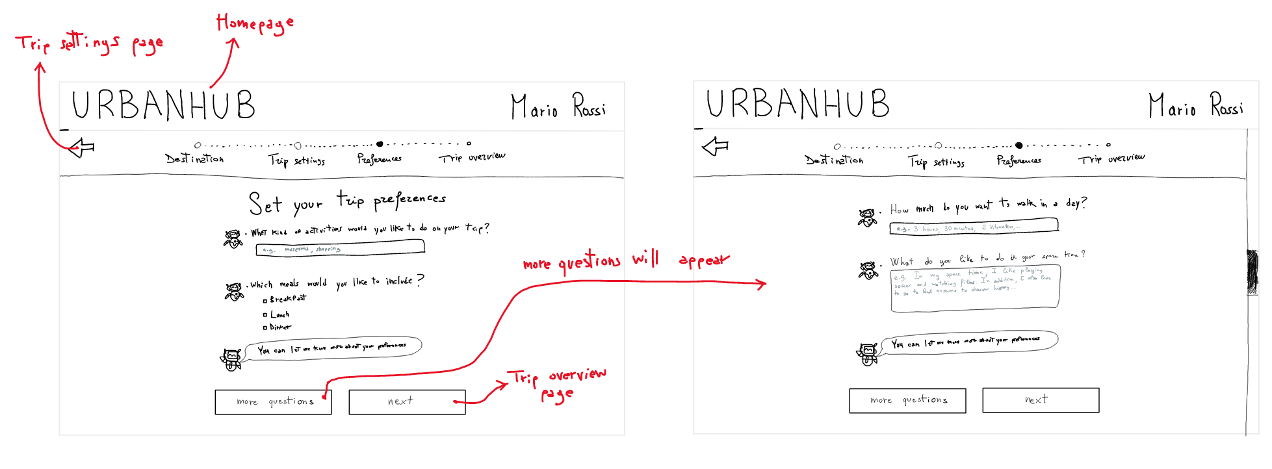
Preferences page

Slide 30
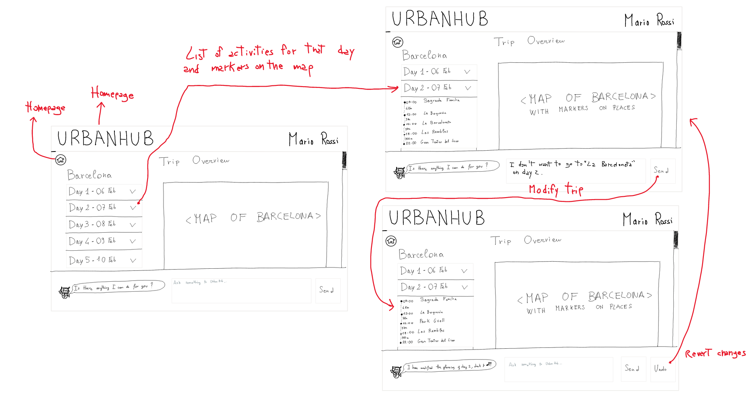
Trip Overview Page

Slide 31
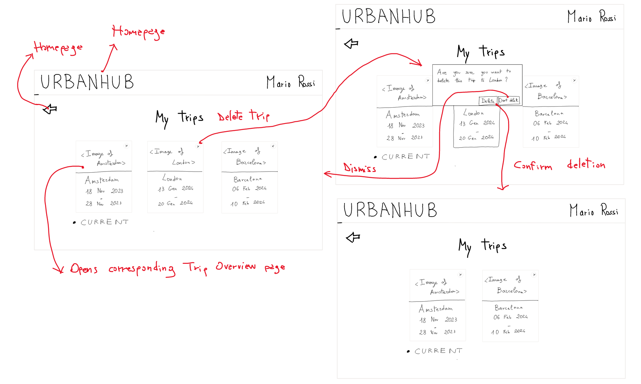
My Trips page

Slide 32
Paper Prototype #1 – Connections with storyboard and tasks
Our Low-Fi Prototype synergistically integrates with an engaging storyboard, bringing to life the narrative of a man seeking a stress-free vacation.
Through three simple tasks - selecting a city, entering preferences, and modifying the itinerary - we provide an intuitive user experience for personalized trip planning.
The end result? The user on vacation, thanks to our app that transforms complex travel planning into a seamless and enjoyable process.

Slide 33
Paper prototype #2
5

Slide 34
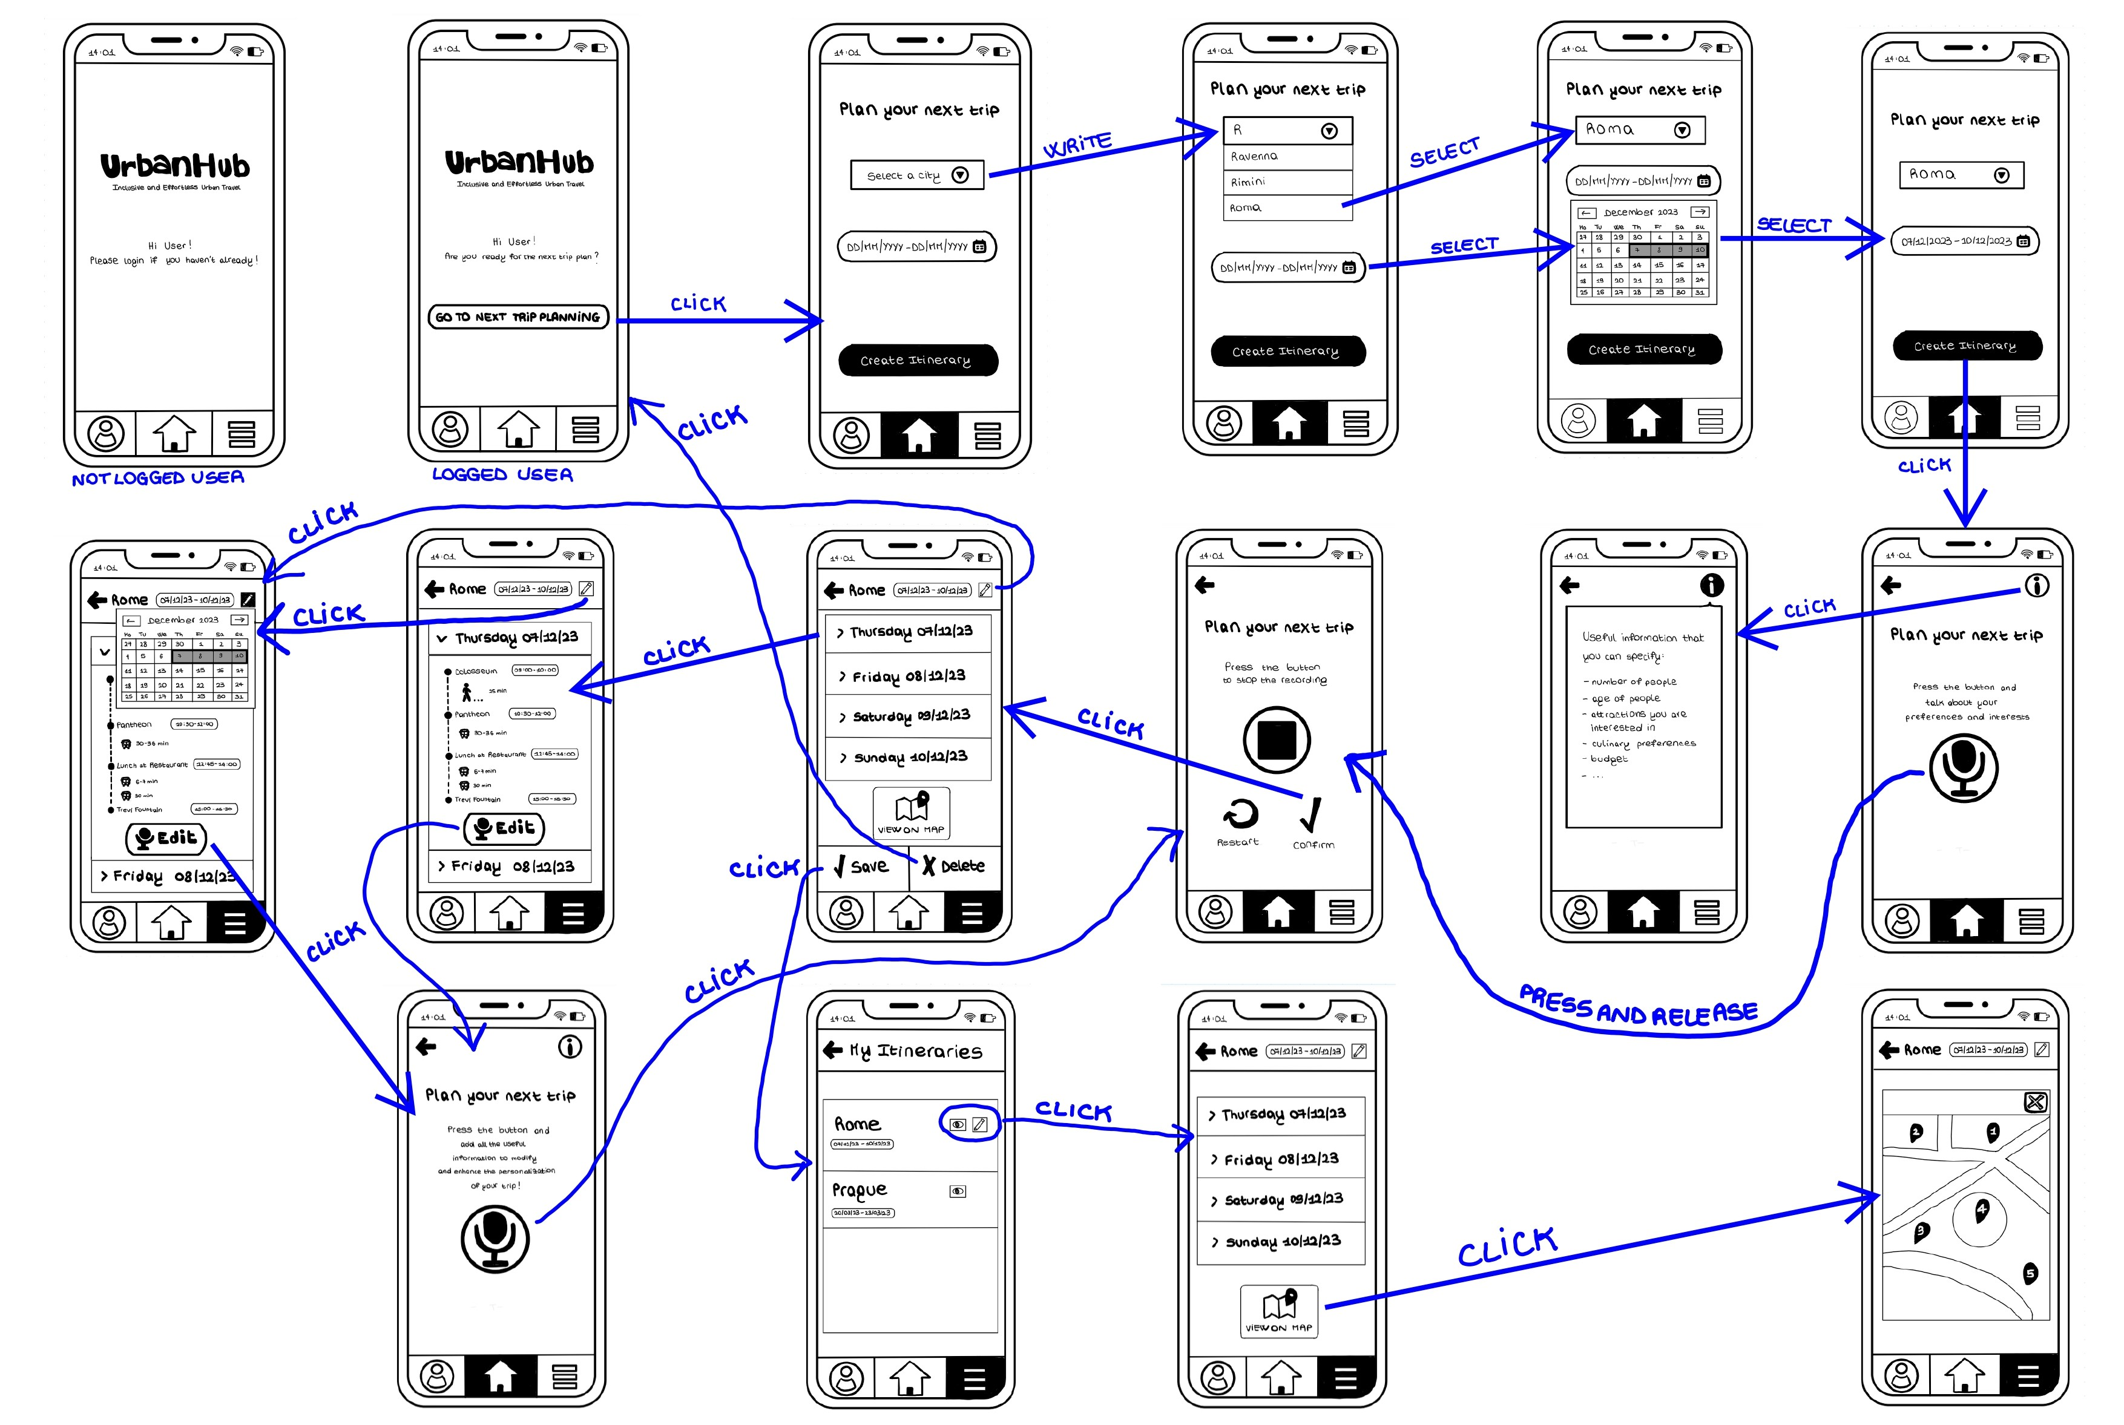

Slide 35
Paper Prototype #2 – Connections with storyboard and tasks
The prototype of the mobile application satisfies all three tasks previously discussed. As also shown in the storyboard, it allows the user to:
Select a destination and a time window.
Indicate preferences as input and obtain an adequate personalized itinerary.
If necessary, user can also provide other specifications and edit the proposed itinerary to generate a new one.

